Slide 1

Mechanics Project (End-sem)
Topic:
Wiper Mechanism
Cb.en.u4aie19002 Abijith
Cb.en.u4aie19009 Srikanth
Cb.en.u4aie19020 Karthik
Cb.en.u4aie19049 Shankar
Cb.en.u4aie19054 nitish
Cb.en.u4aie19073 logesh

Slide 2
WORK BREAKDOWN
Abhijith and Logesh → Simulation
Shankar, Srikanth and Karthik → Analysis
Nitish → Both Simulation and Analysis.

Slide 3
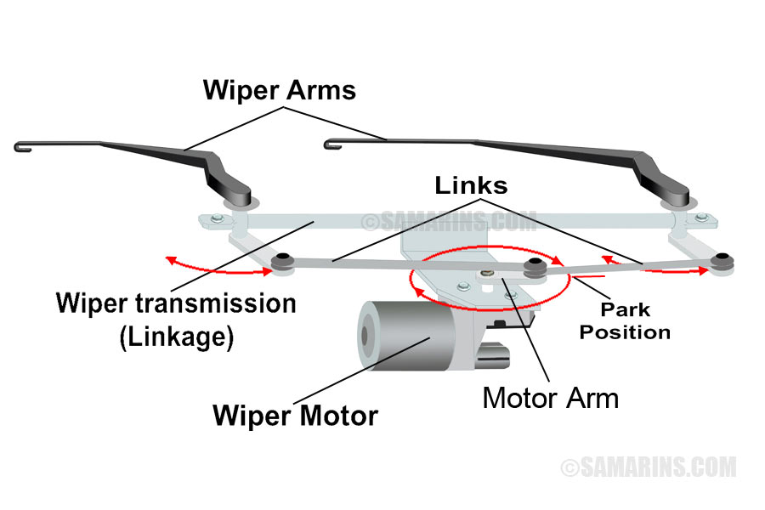
Wiper Mechanism
Wipers work on an inversion mechanism of Basic 4-Bar mechanism, which is very analogous to Beam Engine mechanism.
A windshield wiper is a device designed to remove rain, snow, ice, dirt or debris from a windshield. It is an essential device of nearly every motor vehicle with a cabin.
Cars usually come with two wipers in the front. Arms of windshield wipers are driven trough a mechanism hidden under its front hood. A purpose of the mechanism is to transfer rotation of the drive shaft to swing-like motion of wipers.

Slide 4
How the wiper system works
When you turn the wiper on, the wiper switch sends the signal to the control module. The control module operates the wiper relay. The relay sends 12-volt power to the wiper motor. The motor rotates a little arm through links moves the wiper arms.
This mechanism converts rotary motion of a motor to oscillatory motion which is responsible for back and forth movement of wiper blades.

Slide 5
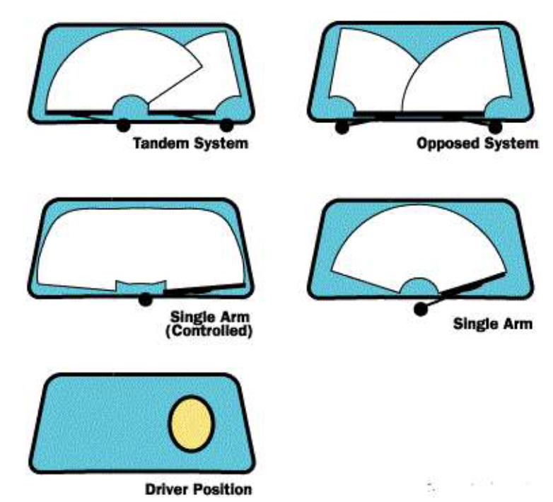
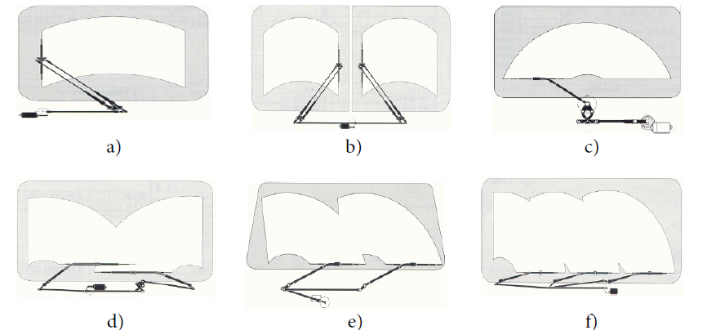
Recent Wiper Systems
Frequent wipers layouts

Slide 6
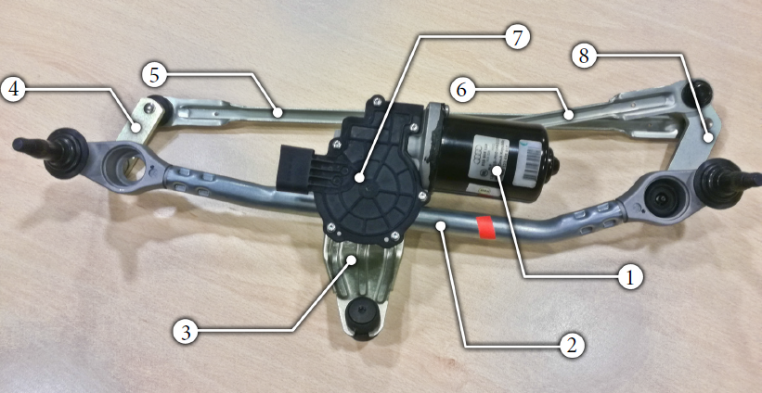
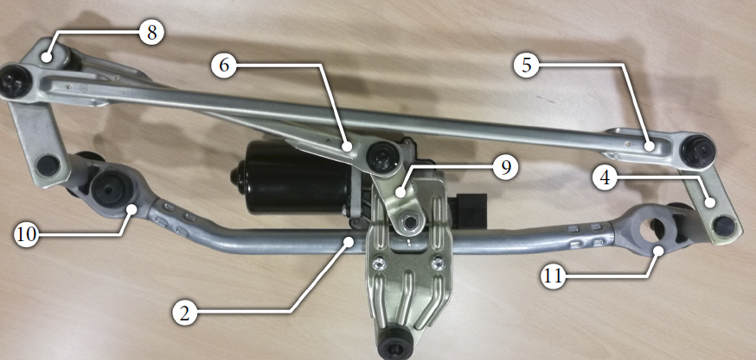
Parts of Wipers
Motion of the mechanism is provided by an electric motor [1] and gearbox [7] , which transfers torque to a crank [9] . The crank is tightened to shaft with hex nut. Its rotation is transferred by a short conrod (connecting rod) [6] to the driver’s lever [8] and from there to passenger’s lever [4] by a long conrod [5] . Motor with gearbox is mounted on a bracket [3] . Whole assembly is fixed to car’s chassis trough housings [10] and [11] which are connected by a connecting tube [2] .
Frontal view
Rear view

Slide 7

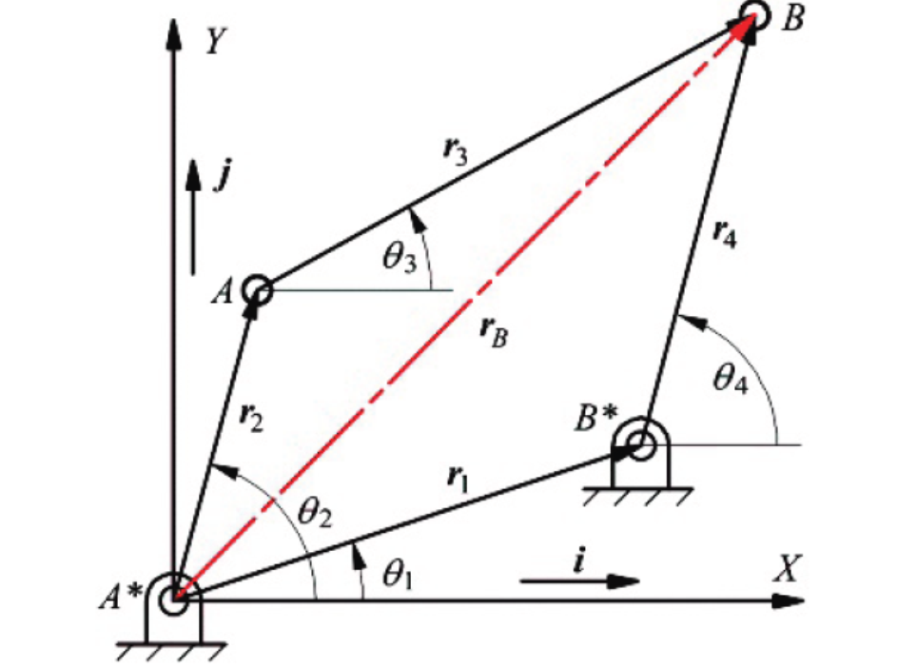
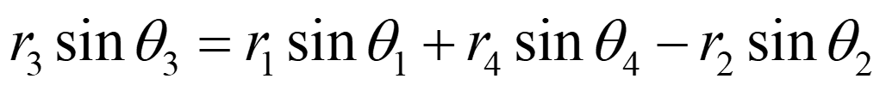

Analysis – Single Wiper
The base vector will be a constant and also( ). Here crank is the driver then will be given. We need to find other angles
$$θ_{1}=0$$

Slide 8
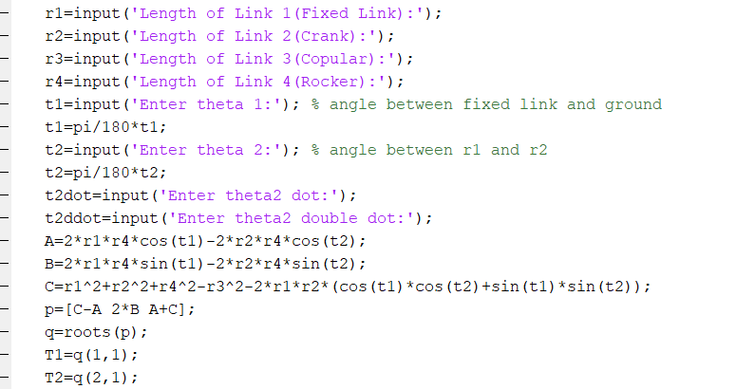
MATLAB Code:

Slide 9
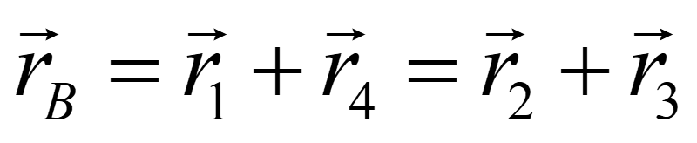
Velocity Equations
Acceleration Equations

Slide 10
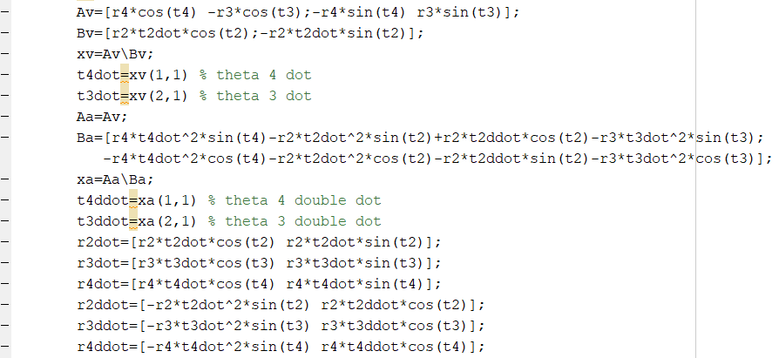
MATLAB Code:

Slide 11
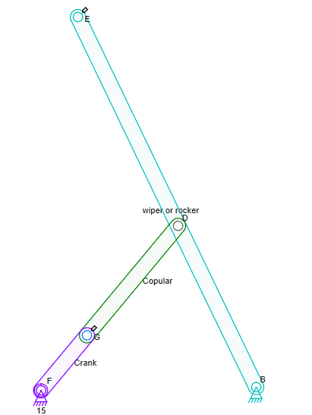
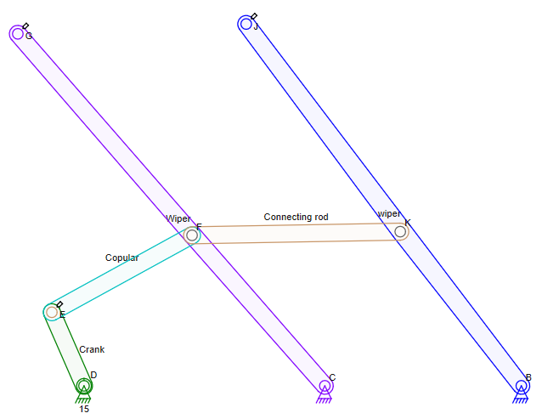
Mechanism taken for our Analysis
FGBD is crank-rocker mechanism.
Here we extend the rocker (BD) to (BE) .
We are adding a parallel rod (BJ) to the wiper with help of the connecting rod (FK) .
Here CFKB act as double rocker.
Here both wipers have same
Velocities at G, J, F, K, C, B.
Accelerations at G, J, F, K, C, B.
Angular velocity of (CG) & (BJ).
Angular acceleration of (CG) & (BJ).
Here the position difference G and J is (in X-axis) length of connecting rod.

Slide 12
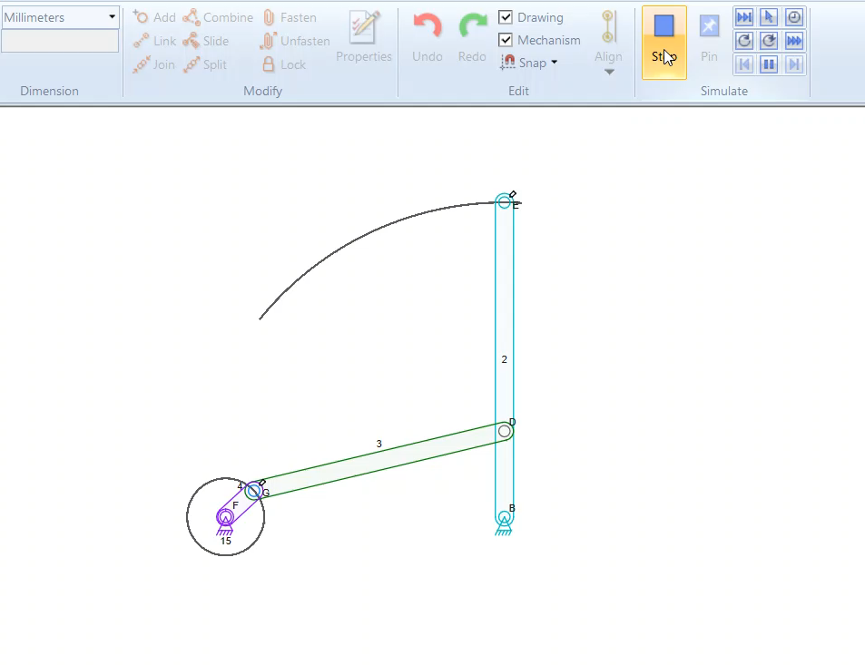
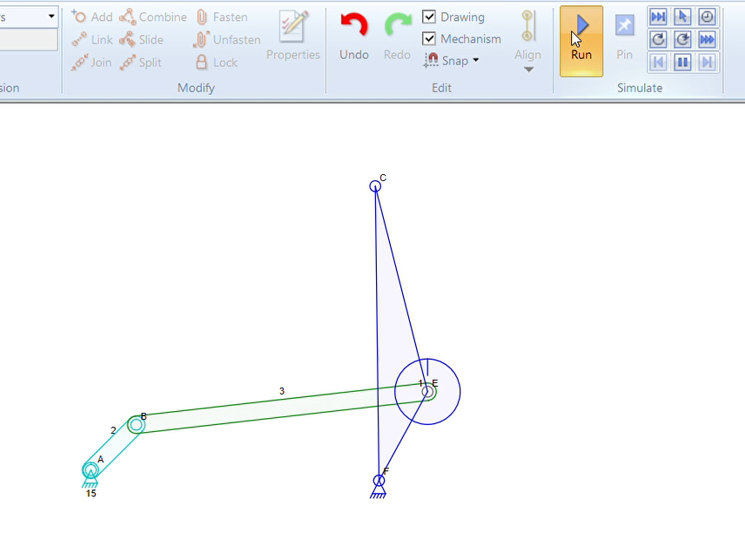
Simulation – Single wiper
Here, BE is the wiper arm….
Here, CE is the wiper arm….

Slide 13
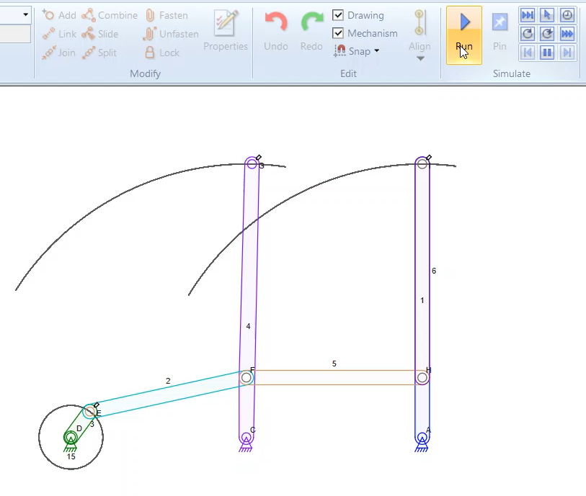
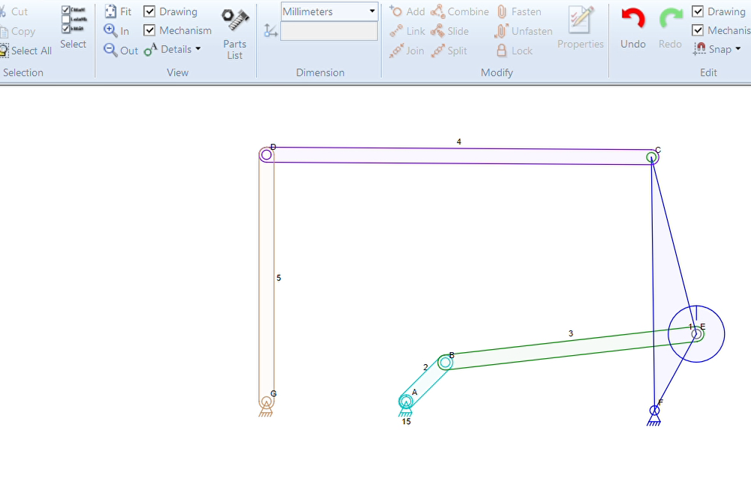
Simulation – Double wiper
Here, GC and IA are the wiper arms….
Here, CE and DG are the wiper arms….

Slide 14
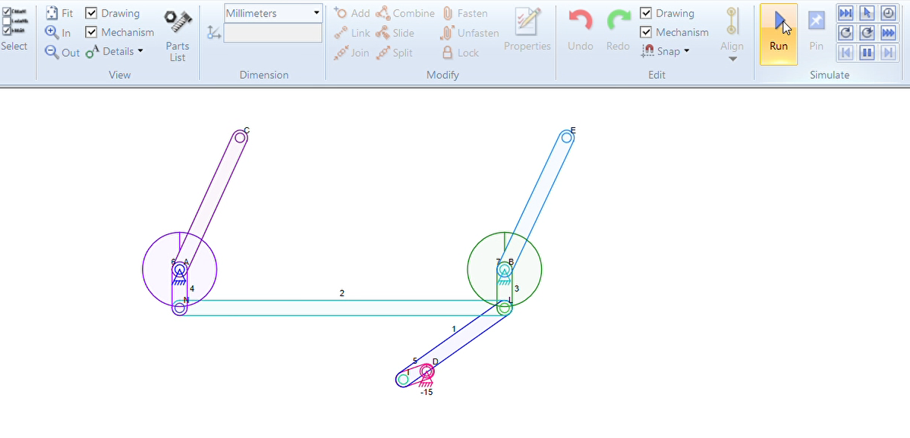
Simulation – Wiper (Real Life)
Here, CA and EB are the wiper arms….

Slide 15
Application-(Rain-sensing Wipers)
In the past, automakers have tried to either eliminate the wipers or to control their speed automatically. Some of the schemes involved detecting the vibrations caused by individual raindrops hitting the windshield, applying special coatings that did not allow drops to form, or even ultrasonically vibrating the windshield to break up the droplets so they don't need to be wiped at all. But these systems were plagued by problems and either never made it to production or was quickly axed because they annoyed more drivers than they pleased. However, a new type of wiper system is starting to appear on cars that actually do a good job of detecting the amount of water on the windshield and controlling the wipers. The sensor projects infrared light into the windshield at a 45-degree angle. If the glass is dry, most of this light is reflected back into the sensor by the front of the windshield. If water droplets are on the glass, they reflect the light in different directions -- the wetter the glass, the less light makes it back into the sensor. The electronics and software in the sensor turn on the wipers when the amount of light reflected onto the sensor decreases to a preset level. The software sets the speed of the wipers based on how fast the moisture builds up between wipes. It can operate the wipers at any speed. The system adjusts the speed as often as necessary to match with the rate of moisture accumulation. The TRW system, which is found on many General Motors cars, including all Cadillac models, can also be overridden or turned off so the car can be washed.

Slide 16
Conclusion
After all results were processed and presented, their credibility should be evaluated. There have been many assumptions needed to be fulfilled, which limit range of their validity. First of all, model of geometry is only approximate – it does not match all the dimensions of original one, that could not be provided. Also, geometry of some parts was very simplified (e.g. shafts, studs) and stress evaluation was not performed on them.
Rigid boundary conditions have been defined in mounting hole of each housing. Real mechanism would be mounted to chassis with certain degree of flexibility, provided by silent-blocks. This could lead to slightly lower stress in certain parts.
All input quantities (except crank’s angle of free rotation in parametric analysis) were considered as deterministic despite the fact that some of them are stochastic by their nature. To evaluate confidence intervals of gained results, some of the inputs should be defined.

